Slide 1
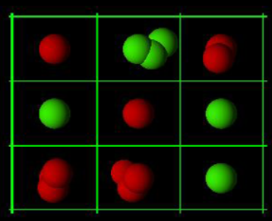
Chain Reaction

Slide 2
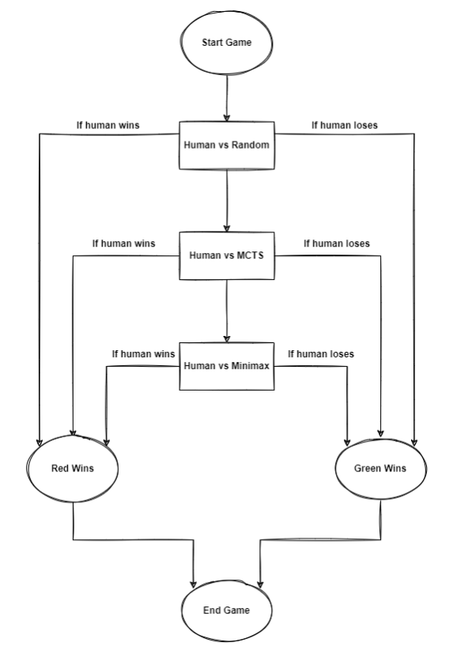

Slide 3
Implementation
Traditional chain reaction game
Player / agent = Bot
3 Types of agents playing:
Random
MCTS
MINIMAX

Slide 4
Traditional Chain Reaction game
Based of carbon atom valency :: polymerization :: it is a type of chain reaction :: atoms multiply
m*n board.
Critical mass = 3 (depending on the placement of the orb/atom)
Players = human vs human (alternate turn)
Initially board = empty
Critical mass of cell reached = explosion of atom resulting in overloading of atom in adjacent cell

Slide 5
Agent 1 - Random
Difficulty = Easy
In the board;
Places the atoms in a random manner.
Plays randomly

Slide 6
Agent 2 - MCTS
Difficulty = Medium
Selection
Expansion
Simulation
Back propagation

Slide 7
Agent 3 - Minimax
Difficulty = Hard
Minimizer
Maximizer
Pruning

